Slide 1
Knowledge Complexity of European Regions
ADAR Project
Nico Pintar
2.2.18

Slide 2
Motivation
For many economies or sub-national regions, the production of complex, unique and tacit knowledge is necessary to uphold their competitive advantage
problem is that the quality of knowledge is not easily measured
Knowledge capital or knowledge base is usually proxied by patents applications per inhabitant or per worker
scholars rely on patent data to study knowledge production
patents are a good proxy for knowledge production and innovation at the regional level.

Slide 3
Motivation
Hidalgo and Hausmann (2009) developed an index to measure Economic complexity of countries and product classes
Inspired from complexity science model → economic complexity is quantified as interplay of diversity and the uniqueness of product classes exported by countries
Based on the bipartite Country - Product group network inferred from export data
Economic complexity index then measures the apparent ability of exporting rare (non-ubiquitous) product groups in the system of countries
Countries that have a high economic complexity are thought to have a competitive edge in global competition because they export product classes that cannot easily be exported by countries

Slide 4
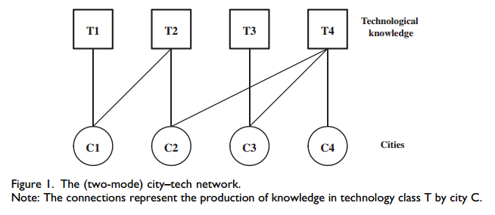
Application to Knowledge production
Balland and Rigby (2017) apply this notion to knowledge production instead of product exports and US city regions instead of countries to coin the term Knowledge complexity
They build a bipartite city – technology network using patent data and can then calculcate knowledge complexity of regions and complexity of technologies using the method of reflection by Hidalgo and Hausmann
Source: Balland and Rigby (2017)

Slide 5
Research Questions – so far
Calculate the Knowledge complexity index (KCI) for European NUTS3 regions
Identify top regions and technologies based on KCI
Show the development of these regions and technologies over time
Show the spatial distribution of knowledge complexity in European sub-national regions and its change over time

Slide 6


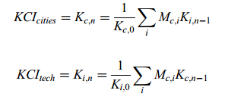
Knowledge Complexity
Using the information from the network one can calculate a matrix of Revealed Technological Advantage which is analogous to RCA in trade theory
A region has revealed technological advantage in a technology if the share of patents produced in that technology class of this region is bigger than the average share of that technology class over all regions
This is the Matrix „M“ which is of dimension region x technology
The method of reflection:
Diversity = number of techn. classes that region c has RCA in
Ubiquity = number of regions that have RCA in techn. class i
measures of complexity of regions and technologies can be calculated by sequentially combining diversity and ubiquity over n iterations
Source: Balland and Rigby (2017)

Slide 7
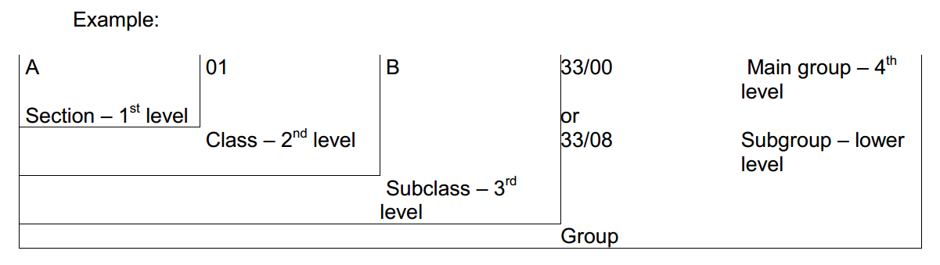
My data
Patent data from REGPAT database of the OECD
contains patent applications to the European Patent Office
Associated with NUTS 3 region of inventor
Time frame: 1990 to 2011
EU 28 countries plus Switzerland and Norway
1,175,764 patents
Technological classification until the IPC group level

Slide 8
Notable Packages
„dplyr“ → for data management
„devtools“ „EconGeo“ → to calculate ECI and RCA
„ggmap“, „maptools“, „rgdal“, „viridis“ → to create dataframes from shapefile and create choropleth maps

Slide 9
Data handling
First step is to create the M matrix from patent data information
Problematic because patent data has many dimensions
One patent is likely developed in more than one regions with more than one inventor listed and belongs likely to more than one IPC technology classes
One patent needs to have a weight of one summed over all dimensions (fractional counting)
Dplyr was very useful for merging different data.frames
Example:
#cut all that is not in the sample area
year.tech.cut.df <- year.tech.cut.df %>% filter(Appln_id %in% region.inv.df$Appln_id)

Slide 10
Data handling
Because I want to show development over time and because patent data is highly irregular over the years I cut my data into two five year sub-periods 1990 – 1994 and 2007 – 2011
Also, because the level of detail in the IPC classification is not needed here I used the 3 digit level IPC level to divide the patents into technological classes
#create two sub-periods: 1990-1994 vs. 2007-2011
period1.vec <- c(1990,1994) ; period2.vec <- c(2007,2011) #####CHANGE#### set year intervals to keep
year.tech.per1.df <- year.tech.cut.df %>% filter((Prio_Year >= period1.vec[1]) & (Prio_Year <= period1.vec[2]))
Number of patents in the two periods
> length(unique(region.inv.per1.df$Appln_id))
[1] 149693
> length(unique(region.inv.per2.df$Appln_id))
[1] 313953

Slide 11
Data handling
#get number of regions per Appln_id
number.NUTS.per1.df <- region.inv.per1.merged.df %>% group_by(Appln_id) %>% summarise(no_reg = length(unique(Reg_code)))
region.inv.per1.merged.ipc.df[which(region.inv.per1.merged.ipc.df$no_pat <1),] #check data base R
region.inv.per1.merged.ipc.df %>% group_by(Appln_id) %>% filter(no_pat < 1) # dplyr
In the end it looked like this:
> head(region.inv.per1.merged.ipc.df,10)
# A tibble: 10 x 10
# Groups: Appln_id [3]
Appln_id Reg_code Ctry_code Reg_share Inv_share no_IPC no_reg frac_pat IPC no_pat
<int> <fctr> <fctr> <dbl> <dbl> <int> <int> <dbl> <fctr> <dbl>
1 2 UKH12 GB 1 0.1667 3 1 0.3333333 C12 1
2 2 UKH12 GB 1 0.1667 3 1 0.3333333 C07 1
3 2 UKH12 GB 1 0.1667 3 1 0.3333333 G01 1

Slide 12
The incidence matrix M
To get the incidence matrix that gives the number of patents per region per technology class:
#incidence matrix of regions x industries
region.ipc.incid.per1.tab <- table(cbind.data.frame(Region=region.inv.per1.merged.ipc.df$Reg_code, IPC=region.inv.per1.merged.ipc.df$IPC))
Calculating the revealed comparative advantage
RCA.per1.tab <- RCA(region.ipc.incid.per1.tab, binary = T)
> head(region.ipc.incid.per1.tab[1:3,10:15])
IPC
Region A45 A46 A47 A61 A62 A63
AT111 0 0 0 0 0 0
AT112 0 0 0 4 0 5
AT113 0 0 0 0 0 0

Slide 13
Knowledge complexity
Calculating the KCI using package EconGeo and normalising its values
#period 1 1990 - 1994
KCI.per1.vec <- KCI(RCA.per1.tab)
KCI.norm.per1.vec <- (KCI.per1.vec - mean(KCI.per1.vec)) / sd(KCI.per1.vec)
Identifiying regions with highest KCI
#find highest and lowest five regions and techs
KCI.both.df %>% arrange(desc(KCI_per1)) %>% top_n(5, KCI_per1)
KCI.both.df %>% arrange(desc(KCI_per2)) %>% top_n(5, KCI_per2)

Slide 14
Top Knowledge complexity
> KCI.both.df %>% arrange(desc(KCI_per1)) %>% top_n(5, KCI_per1)
KCI_per1 NUTS_ID KCI_per2 diff
1 1.457027 RO421 -0.1637907 -1.6208174
2 1.439762 PL331 0.2582295 -1.1815324
3 1.433461 BGZZZ -1.8745144 -3.3079750
4 1.433461 FR930 0.8170734 -0.6163872
5 1.298570 DE401 -0.9023680 -2.2009383
> KCI.both.df %>% arrange(desc(KCI_per2)) %>% top_n(5, KCI_per2)
KCI_per1 NUTS_ID KCI_per2 diff
1 1.1361455 DE262 1.624995 0.4888499
2 0.8600833 DEA18 1.413050 0.5529668
3 0.5679159 DE124 1.412022 0.8441058
4 0.8675223 AT121 1.390644 0.5231218
5 0.5403042 DE266 1.372344 0.8320395

Slide 15
Top Technological complexity
> TCI.norm.per1.df %>% arrange(desc(TCI)) %>% top_n(5, TCI)
TCI IPC
1 5.037173 C07 ORGANIC CHEMISTRY
2 3.729833 A61 Medical or veterinary science; Hygiene
3 3.301061 B82 Nano-technology
4 2.964033 C12 Biochemistry;
5 2.244586 C08 Organic macromolecular compounds;
> TCI.norm.per2.df %>% arrange(desc(TCI)) %>% top_n(5, TCI)
TCI IPC
1 1.552935 B24 Grinding; Polishing
2 1.520437 F15 Hydraulics or pneumatics in general
3 1.511135 B25 Hand tools; Portable power-driven tools;
4 1.480386 C21 Metallurgy of iron
5 1.442411 B23 Machine tools;

Slide 16
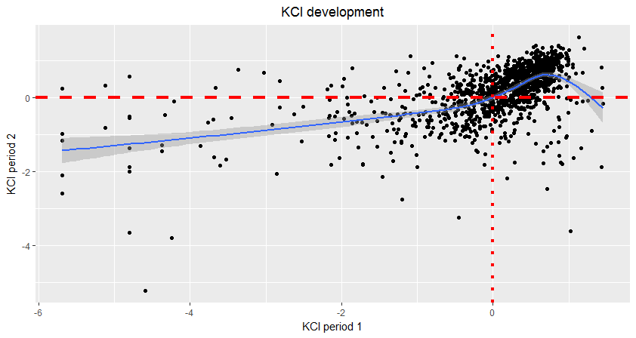
scatter.kci <- ggplot(KCI.both.df, aes(x=KCI.both.df$KCI_per1, y=KCI.both.df$KCI_per2)) +
geom_point() + geom_smooth() +labs(x = "KCI period 1", y = "KCI period 2", title = "KCI development") +
theme(plot.title = element_text(hjust = 0.5)) + geom_hline(yintercept=0, linetype="dashed", color = "red", size= 1.5) + geom_vline(xintercept = 0, linetype="dotted", color = "red", size = 1.5)

Slide 17
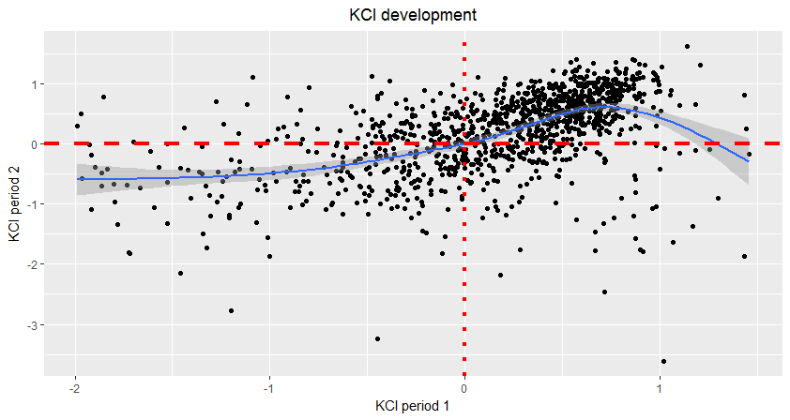
Without KCI period 1 < -2

Slide 18
KCI Development
It seems that for most regions the development of the KCI from period 1 to period 2 follows a slight „S“ curve
Regions that were behind in period 1 caught up but some already complex regions in period 1 lost knowledge complexity (higher unvertainty though)
Shows a clear path dependency of complex knowledge production
Can we see a spatial pattern?

Slide 19
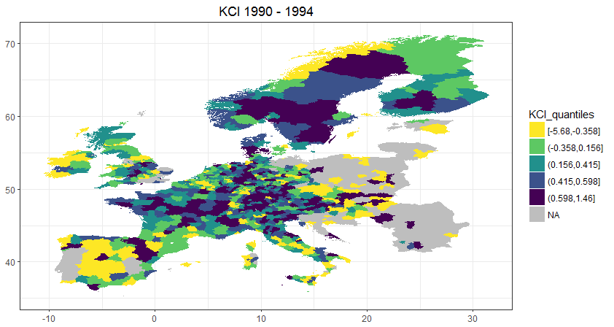
map_per1 <- ggplot() + geom_polygon(data = map_data_per1, aes(fill = KCI_quantiles, x = long,
y = lat, group = group)) + labs(x = NULL, y = NULL, title = "KCI 1990 - 1994") +
theme_bw() + scale_fill_viridis(discrete = T, na.value = "grey", direction = -1) +theme(plot.title = element_text(hjust = 0.5))

Slide 20
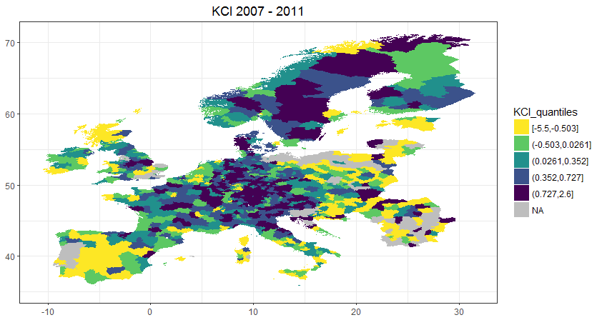

Slide 21
KCI spatial development
Pattern has not visibly changed that much
Central and Northern regions highly complex
If anything, central regions have increased complexity even more
But, map of changes in KCI show different picture
Easter and Southern regions have visibly caught up

Slide 22
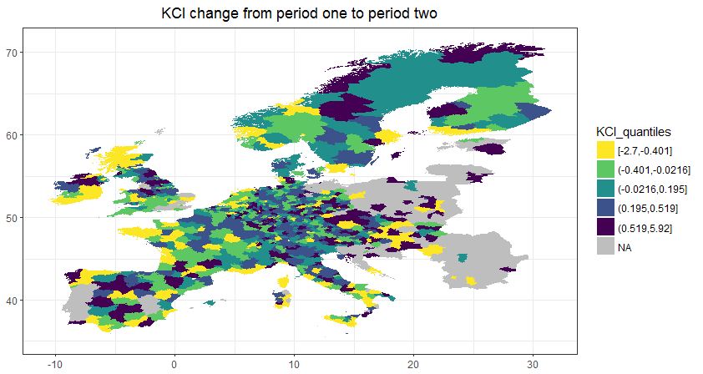

Slide 23
Summary
Knowledge complexity shows a stable, path dependent development
slight tendencies of catching up of lacking regions
Limitations:
Problems with shapefiles for mapping, so not all regions are actually mapped (but KCI calculated)
Further work:
Refine network in terms of regional level and IPC classes and time periods
It is then possible to plot a meaningful maximum spanning tree graph to visualise network structure

